Slide 1

Predicting Heart Disease
Pavan Kalyan Muniyappa
APPLIED STATS FOR RESEARCH-DATA-6000-01
Notes:
“Hello everyone, my name is Pavan Kalyan Muniyappa.
Today I will be presenting my project titled Predicting Heart Disease, created for Applied Statistics for Research.
This study compares two statistical learning models to identify which one predicts heart disease more accurately.”

Slide 2
Introduction
Research Question
Goal
The key inquiry guiding this study is: Which model predicts heart disease more accurately — Logistic Regression or KNN? This question aims to explore each model's effectiveness.
The primary objective is to compare two statistical learning models to determine their efficacy in predicting heart disease, which is critical for improving clinical decision-making.
Background
Why important?
Heart disease is one of the leading causes of mortality; early prediction helps intervention.
Early prediction helps with clinical decision-making.
Notes:
The main research question guiding this project is: Which model predicts heart disease more accurately — Logistic Regression or KNN?
The goal is to compare these two models and understand their strengths.
Heart disease remains one of the leading causes of mortality, so early prediction can make a major difference in clinical decision-making.”

Slide 3
Dataset Overview
Insights into the dataset used
Dataset
Target Variable
The dataset contains 1,025 rows and 14 predictors alongside the target variable, providing a robust foundation for our analysis of heart disease prediction models.
The target variable is binary, indicating presence or absence of heart disease, with a nearly balanced distribution of 499 and 526 instances, ensuring reliable model training.
Notes:
The dataset used contains 1,025 patient records and 14 clinical predictor variables.
The target variable is binary — indicating whether heart disease is present or not.
The classes are almost evenly distributed with 499 ‘no’ and 526 ‘yes’, which provides a good balance for training both models.”

Slide 4


Key Variables
Numeric
Categorical
Important Patterns
Age, trestbps, chol, thalach, oldpeak, ca
sex, cp, fbs, restecg, exang, slope, thal
cp, oldpeak, and thalach show strong separation.
Notes:
The dataset includes both numerical and categorical variables.
Key numeric variables include age, blood pressure, cholesterol, and ST depression.
Categorical variables include chest pain type, fasting blood sugar, ECG results, and more.
Early analysis showed that chest pain type, oldpeak, and maximum heart rate show strong separation between patients with and without heart disease.

Slide 5
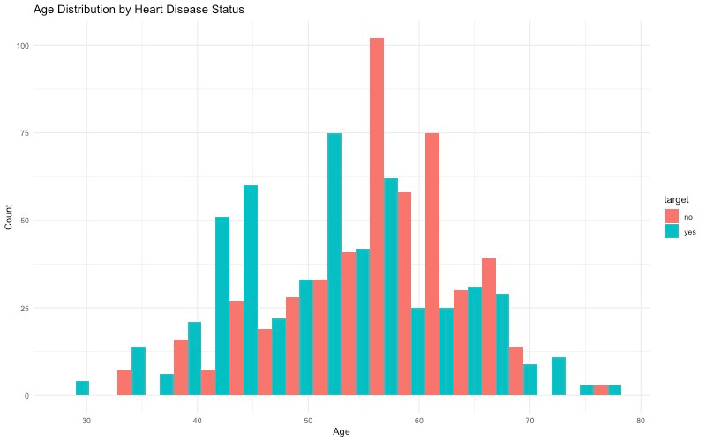
Exploratory Data Analysis
Age Histogram: Shows that heart disease appears across all ages, but slightly more frequent in mid-to-older age groups.
Notes:
EDA: Age Histogram
📍 Page 5
Script:
“This histogram shows how age is distributed across both groups.
Heart disease appears across all ages, but it is slightly more common in the mid-to-older age range.
This gives us useful background on the patient population.”

Slide 6
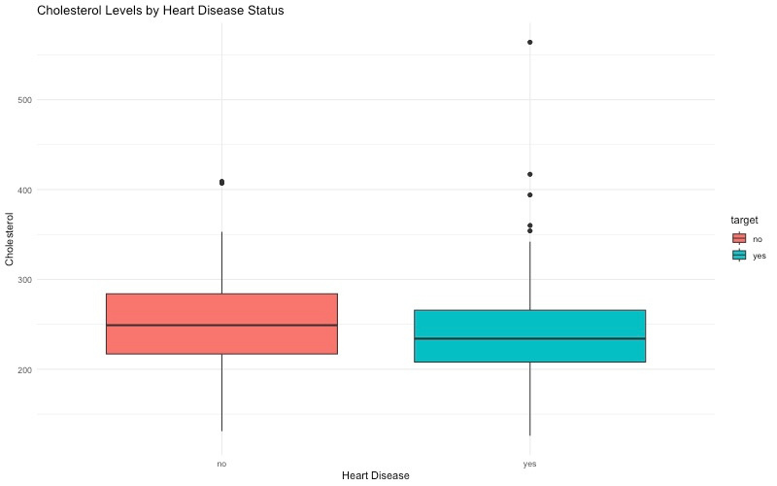
Exploratory Data Analysis
Cholesterol Boxplot: Displays the distribution differences in cholesterol levels between the two groups.
Notes:
EDA: Cholesterol Boxplot
📍 Page 6
Script:
“This boxplot compares cholesterol levels between the two groups.
We can see variation in cholesterol across both categories, but not a strong split — suggesting cholesterol alone may not be a strong predictor in this dataset.”

Slide 7
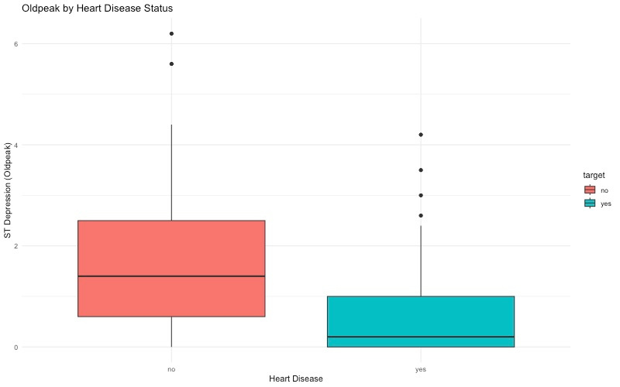
Exploratory Data Analysis
Oldpeak Boxplot: Highlights ST depression—one of the strongest visual indicators of heart disease.
Notes:
EDA: Cholesterol Boxplot
📍 Page 6
Script:
“This boxplot compares cholesterol levels between the two groups.
We can see variation in cholesterol across both categories, but not a strong split — suggesting cholesterol alone may not be a strong predictor in this dataset.”

Slide 8
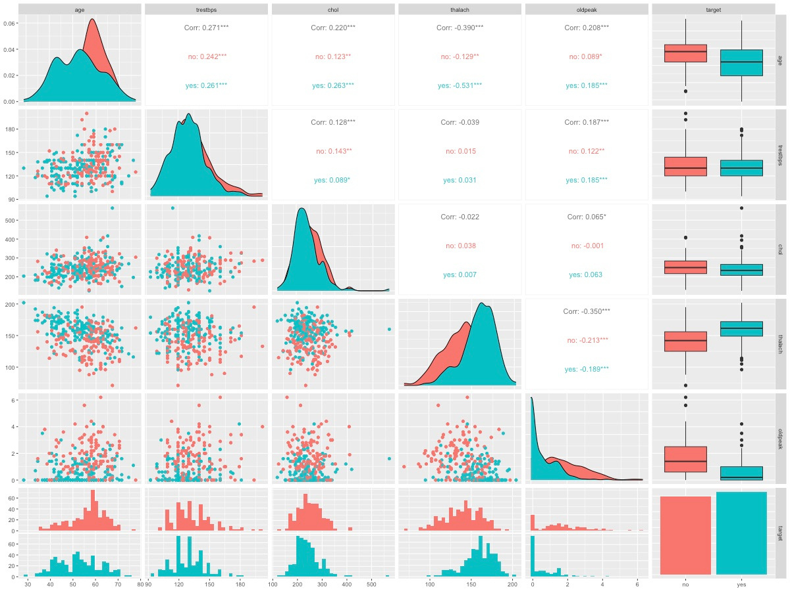
Relationships
Notice clear separation for oldpeak and thalach
Correlation patterns help justify model choice
Notes:
Relationship Plot (Pairwise)
📍 Page 8
Script:
“This pairplot shows relationships among key variables.
We notice that both oldpeak and thalach show strong separation between the two classes.
These correlation patterns helped guide model selection.”

Slide 9
Methodology
Understanding the approach to model selection
Models Used
Train/Test Split
Two models were employed: Logistic Regression for its interpretability and KNN for its ability to capture complex patterns, allowing for a comprehensive analysis of heart disease prediction.
The dataset is divided into an 80% training set and a 20% test set, ensuring robust evaluation of model performance while minimizing overfitting risk during training.
KNN preprocessing: centering + scaling
KNN tuned using CV → best K = 3
Logistic Regression used directly with factors
Notes:
For training, the dataset was split into 80% training and 20% testing.
Two models were applied: Logistic Regression for interpretability, and KNN for capturing nonlinear patterns.
KNN required preprocessing with centering and scaling, and we tuned the model using repeated cross-validation, which selected K = 3 as the optimal value.”

Slide 10
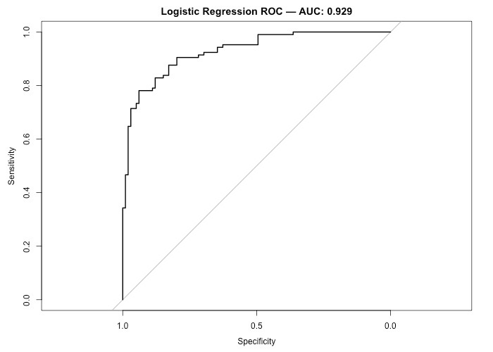
Logistic Regression ROC Curve
Notes:
Script:
“This is the ROC curve for logistic regression.
The model achieved an AUC of 0.93, which shows strong ability to distinguish between the two classes.

Slide 11
Logistic Regression
Key Predictors Identified
Chest pain type (cp), maximum heart rate (thalach), ST depression (oldpeak), number of major vessels (ca), cholesterol, sex.
Interpretation
Logistic regression provides strong interpretability and reveals clinically meaningful predictors.
Accuracy
Sensitivity
Specificity
AUC
0.8431 achieved overall accuracy
Detects heart disease at 88.57%
Identifies negatives at 79.80%
Area Under Curve is 0.9286
Notes:
On the test dataset, logistic regression achieved 84% accuracy.
It had a high sensitivity of 88%, meaning it detects disease cases well.
The specificity was 79%.
Important predictors identified include chest pain type, maximum heart rate, ST depression, and number of major vessels.”

Slide 12
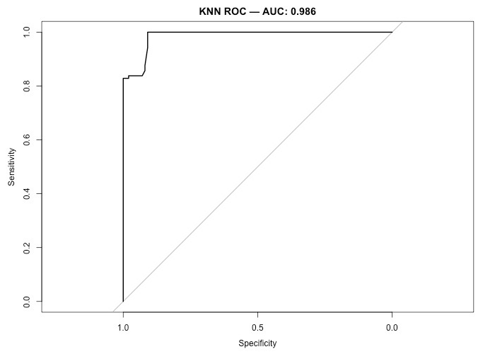
KNN ROC Curve
Notes:
Script:
“This is the ROC curve for the KNN model.
It achieved an exceptional AUC of 0.986, indicating nearly perfect class separation.

Slide 13

KNN Results
Interpretation
KNN provides excellent predictive performance, especially in distinguishing healthy vs diseased participants.
Best
Accuracy
Sensitivity
Specificity
Best K = 3 chosen
Achieved 0.8775 accuracy rate
Sensitivity rate of 0.8381
High specificity at 0.9192
Notes:
KNN with K = 3 achieved the highest overall accuracy of 87.75%.
Its specificity was very strong at 91.9%, meaning it is very good at detecting non-disease cases.
Sensitivity was also strong at 83.8%.”

Slide 14
Model Comparison Overview
Logistic Regression
KNN
Conclusion
Basic statistical model
Nonlinear and flexible approach
KNN proves to be superior
Summary
KNN outperforms Logistic Regression in both accuracy and AUC.
Logistic Regression has slightly higher sensitivity.
KNN has much higher specificity and nearly perfect AUC.
Interpretation
For predictive performance → KNN is the better model. For interpretability → Logistic Regression remains useful.
Notes:
When directly comparing the two models, KNN outperformed logistic regression in both accuracy and AUC.
Logistic regression had slightly higher sensitivity, but KNN achieved higher specificity and overall performance.
For prediction accuracy, KNN is the superior model, while logistic regression remains more interpretable.”

Slide 15
Model Comparison Table
Model | Accuracy | Sensitivity | Specificity | AUC
Logistic Regression | 0.84314 | 0.88571 | 0.79798 | 0.92862
KNN (K=3) | 0.87745 | 0.83810 | 0.91919 | 0.98591
Notes:
This table summarizes the performance metrics.
KNN leads with the highest accuracy and AUC, while logistic regression performs well but slightly below in key areas.
This confirms our previous observations.”

Slide 16
Discussion & Limitations
Exploring strengths and weaknesses together
Strengths
Limitations
KNN captures nonlinear relationships effectively, allowing it to identify complex patterns that logistic regression may overlook, enhancing the model’s predictive power in heart disease forecasting.
The absence of an external validation dataset limits the applicability of the findings, and some coefficients in logistic regression can be influenced by the encoding of categorical factors.
Future Work
Test SVM or Random Forest.
Try PCA or feature selection.
Validate on a different patient dataset.
Notes:
“KNN effectively captures nonlinear relationships, making it strong in predictive tasks.
Limitations include the lack of an external validation dataset and some logistic regression coefficients being influenced by variable encoding.
Future work includes trying SVM or Random Forest, experimenting with PCA, and validating the models on new patient data.”

Slide 17
Conclusion
Key Takeaways
Best Model: KNN (K=3)
Why: Highest accuracy and AUC
Key Predictors Identified: Oldpeak, cp, thalach, ca
Outcome: Supports early detection of heart disease
Notes:
“In conclusion, the best performing model is KNN with K = 3, due to its high accuracy and near-perfect AUC.
Important predictors included oldpeak, chest pain type, maximum heart rate, and vessel count.
This model can support early detection of heart disease and help improve clinical decisions.”

Slide 18
Thank You

